Slide 1
Beauty is in the ear of the beholder
Icons meetup

Slide 2

Modern art

Slide 3

Interior design

Slide 4
Architecture

Slide 5



GUI architecture

Slide 6

VUI architecture

Slide 7
Character

Slide 8

Reed and friends
Robotic Adult Male: “Hello, this is the voice of Reed,”
Robotic Adult Female: “this is the voice of Shelly,”
Robotic Male Child: “this is the voice of Bobby,”
Robotic Deep Adult Male: “this is the voice of Rocko,”
Robotic High Adult Male: “this is the voice of Glen,”
Robotic High Adult Female: “this is the voice of Sandy,”
Robotic Elder Female: “this is the voice of Grandma,”
Robotic Elder Male: “and this is the voice of Grandpa.”

Slide 9
Evan, Nathan, and Tom
Natural Adult Male: “Hello, my name is Evan,”
Natural Deep Adult Male: “my name is Nathan,”
Natural Deeper Male Adult: “and my name is Tom”

Slide 10
Alison, Ava, and Zoë
Natural Adult Female: “Hello, my name is Alison,”
Natural Deep Adult Female: “my name is Ava,”
Natural Light Female Adult: “and my name is Zoë.”

Slide 11
Oliver and friends
Natural Adult Male: “Hello, I'm Oliver, from England”
Natural Adult Female: “I'm Stephanie, also from England.”
Natural Adult Female: “I'm Moira, from Ireland,”
Natural Adult Female: “and I'm Fiona, from Scotland.”
Natural Adult Male: “I'm Rishi, from India,”
Natural Adult Female: “and I'm Sangaeta, also from India.”
Natural Adult Female: “I'm Karen, from Australia.”
Natural Adult Male: “I'm Lee, and I'm from Australia too,”
Natural Adult Female: “and finally, I'm Tessa, from South Africa.”

Slide 12
Meet Q
Natural Gender Neutral Adult: “Hello, I'm Q, the world's first genderless voice assistant.
I'm created for a future where we're no longer defined by gender, but rather, how we define ourselves.
My voice was recorded by people who neither identify as male nor female and then altered to sound gender neutral, putting my voice somewhere between 145 and 175 Hertz.
But, for me to become the third option for voice assistants, I need your help. Share my voice with Apple, Amazon, Google, and Microsoft, and together we can ensure that technology recognises us all.
Thanks for listening. Q.”

Slide 13
Zoë Vocalizer Expressive 2
Natural Light Adult Female:
“For millions of years, humans lived just like the animals, then something happened which unleashed the power of our imagination; we learned to talk.”

Slide 14
Zoë Vocalizer Expressive 7
Almost Human Light Adult Female:
“For millions of years, humans lived just like the animals, then something happened which unleashed the power of our imagination; we learned to talk.”

Slide 15
Design

Slide 16
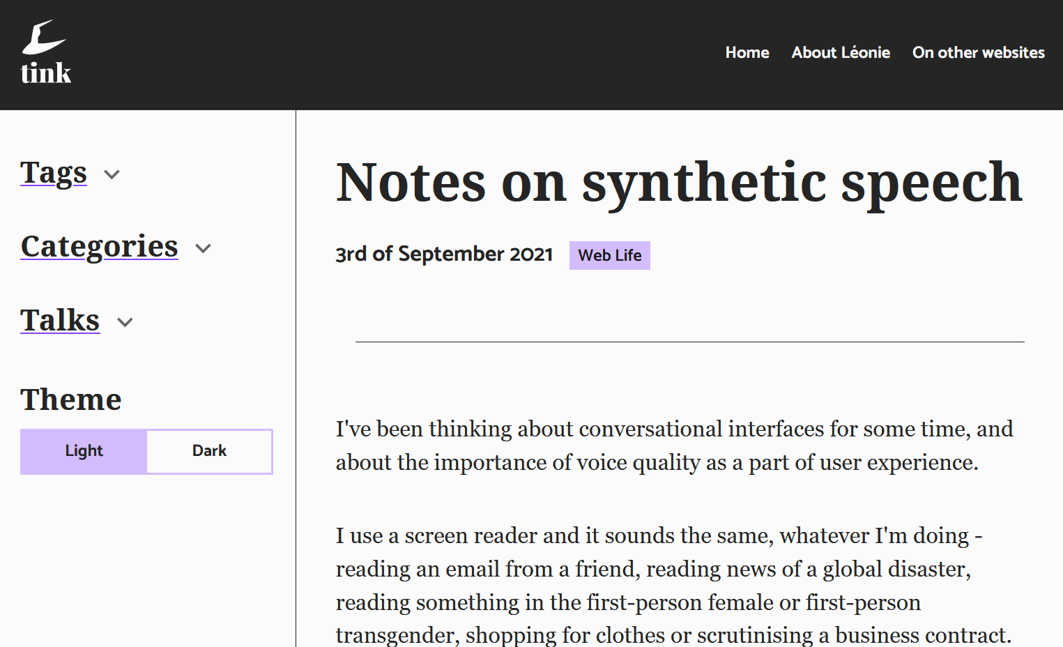
Reader mode

Slide 17
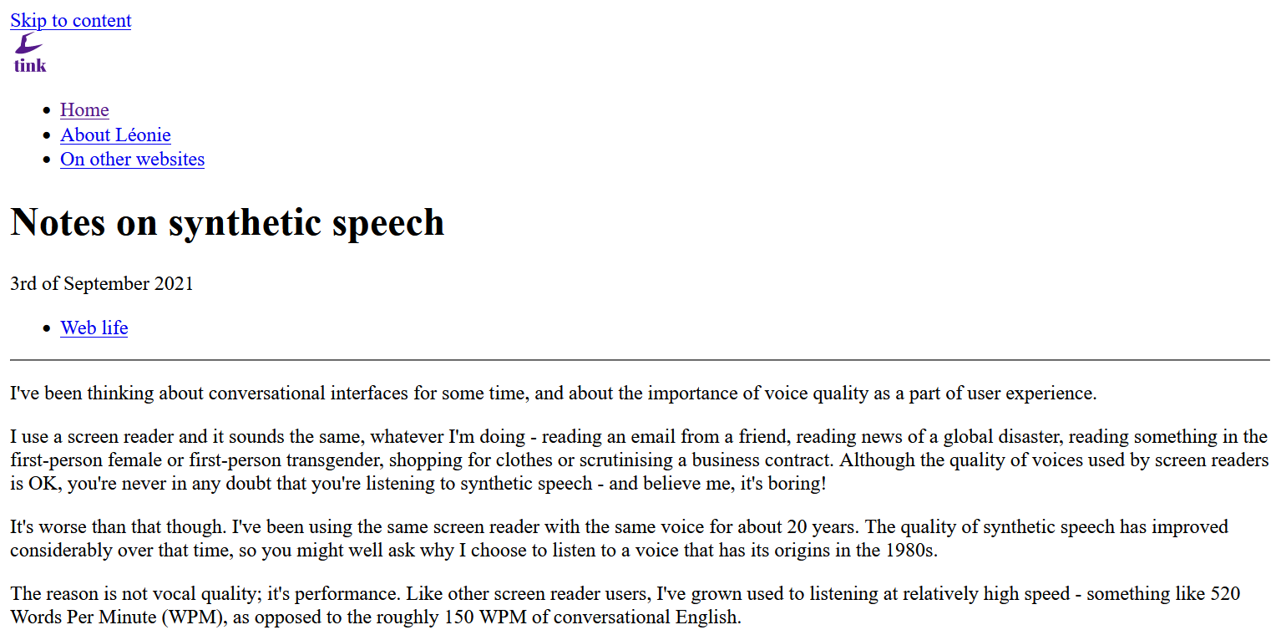
No style

Slide 18

CSS Speech
Working Group Note (2019)
W3C Candidate Recommendation (2020)

Slide 19
Proof of concept

Slide 20
SSML
SSML 1.0 W3C Recommendation (2004)
SSML 1.1 W3C Recommendation (2010)

Slide 21
SSML: voice and emphasis elements
let responsePrompt =
`<voice name='Matthew'>
<p>
The <emphasis level='moderate'>terror</emphasis>, which would not end for
another 28 years - if it ever <emphasis level='moderate'>did</emphasis> end
- began, <emphasis level='reduced'>so far as I know or can tell</emphasis>,
with a boat made from a sheet of newspaper floating down a gutter
<emphasis level='moderate'>swollen</emphasis> with
<emphasis level='moderate'>rain</emphasis>.
</p>
</voice>`;

Slide 22
SSML: lang and break elements
let responsePrompt =
`<voice name='Enrique'>
<lang xml:lang='es-ES'>
<p>Hello, <break time='500ms'/> my name is Inigo Montoya.
You killed my father. <break strength='x-strong'/>Prepare to die!</p>
</lang>
</voice>`;

Slide 23
SSML: prosody element
let responsePrompt =
`<voice name='Brian'>
<s>Piglet sidled up to Pooh from behind.</s>
<s><prosody pitch='x-high' rate='medium' volume='soft'>'Pooh'</prosody>
he whispered.</s>
<s>'Yes, Piglet?'</s>
<s><prosody pitch='x-high' rate='x-fast'>'Nothing',</prosody>
said Piglet, taking Pooh's paw. <prosody pitch='x-high' rate='x-fast'>
'I just wanted to be sure of you'.</prosody></s>
</voice>`;

Slide 24
HTML
<p>Будь сильною Україно</p>
Natural Adult Female (English Accent):
“Будь сильною Україно”

Slide 25
HTML: lang attribute
<p lang="uk">Будь сильною Україно</p>
Natural Adult Female (Ukrainian Accent):
“Будь сильною Україно”

Slide 26
HTML: lang attribute
<p>Het zit wel snor.</p>
Natural Adult Female (English Accent):
“Het zit wel snor.”

Slide 27
HTML: lang attribute
<p lang="nl">Het zit wel snor.</p>
Natural Adult Male (Dutch Accent):
“Het zit wel snor.”

Slide 28
Content

Slide 29
Describe images

Slide 30

Baloons

Slide 31
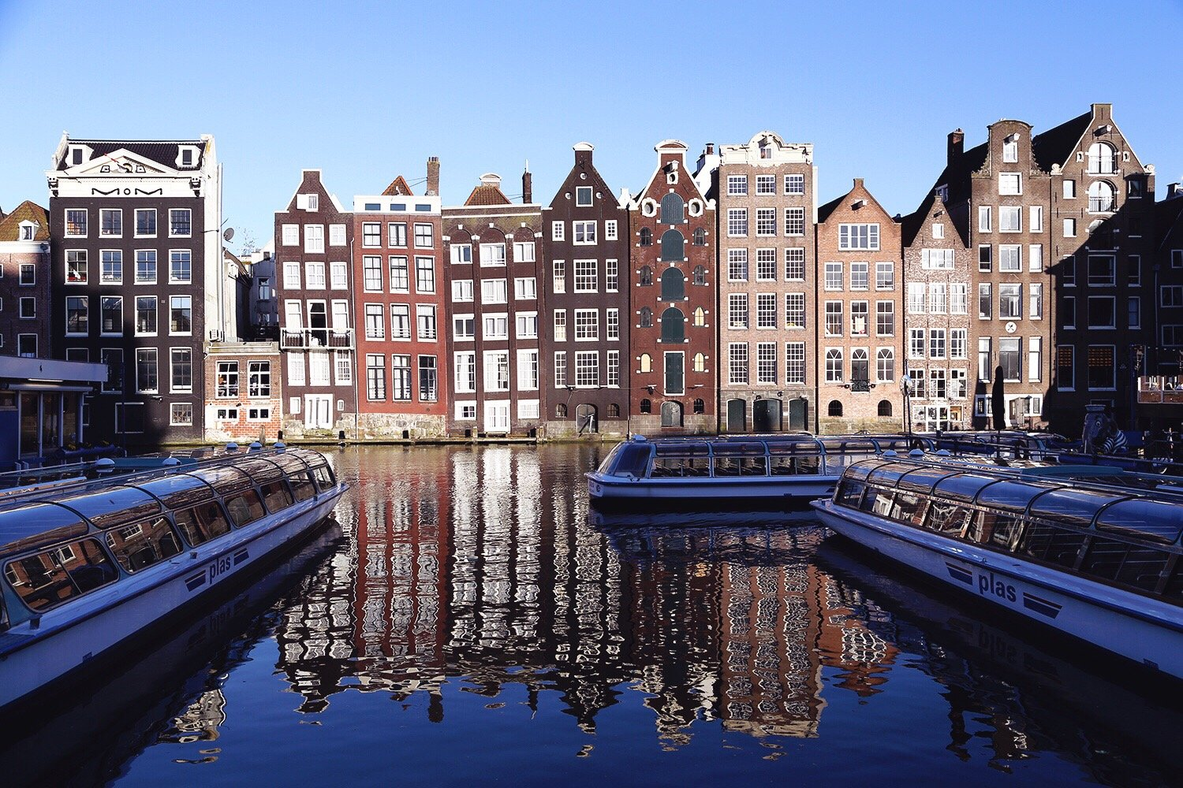
Houses

Slide 32
Build things properly

Slide 33
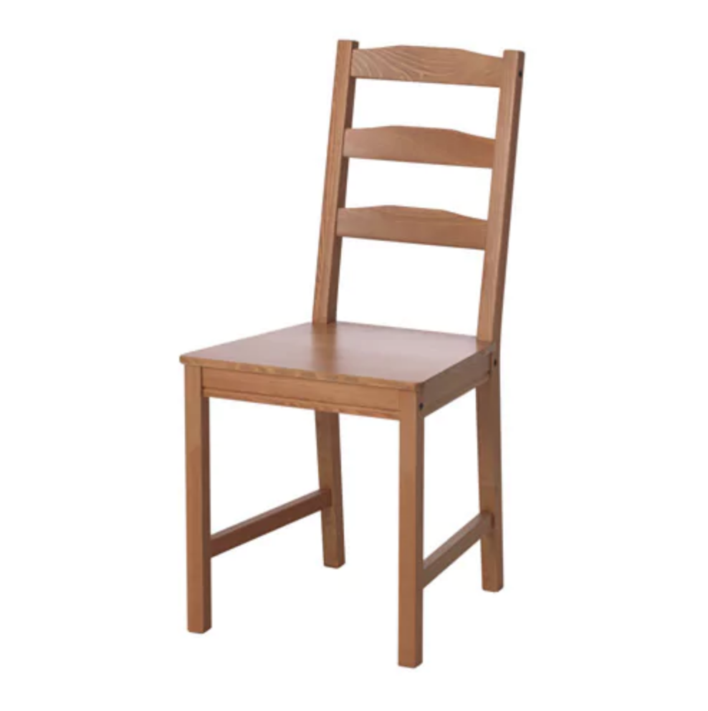
Object

Slide 34
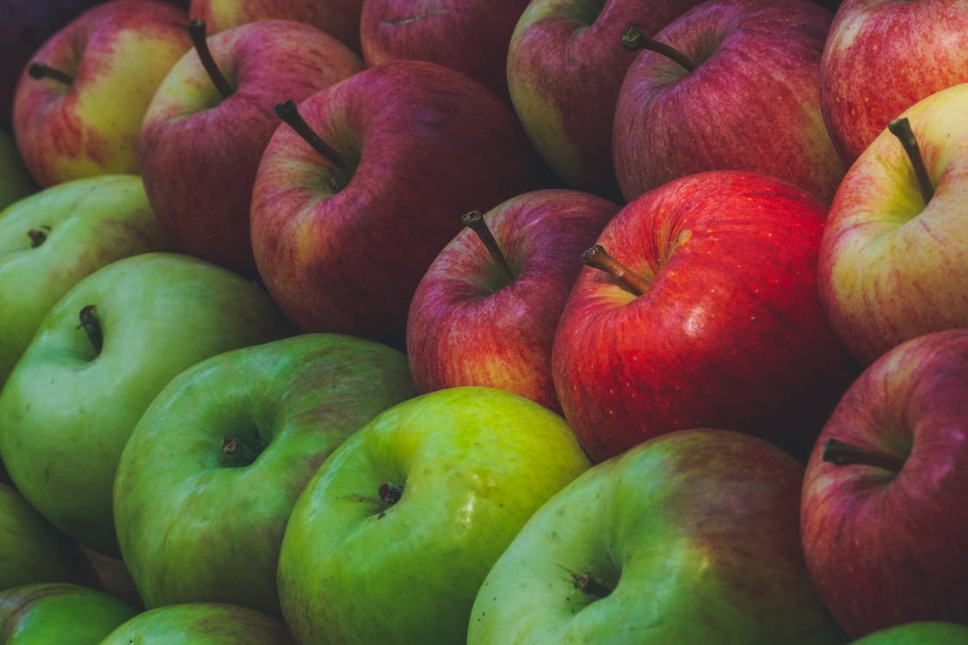
Object and properties

Slide 35
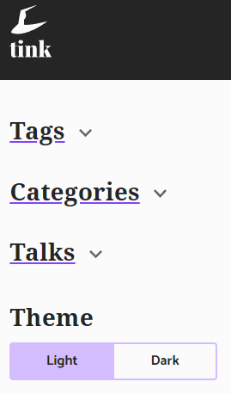
Toggle button

Slide 36
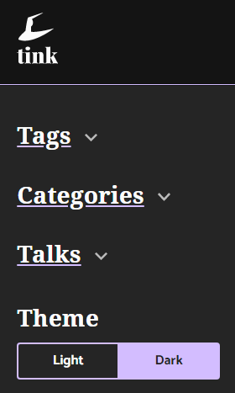
Toggle button

Slide 37
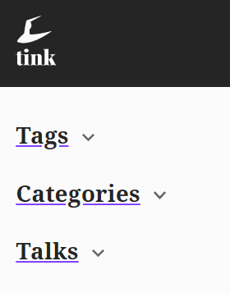
Disclosure component

Slide 38
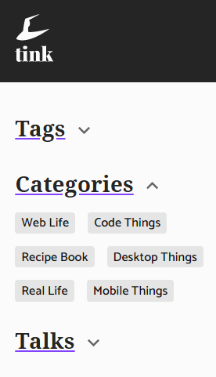
Disclosure component

Slide 39
Write proper content

Slide 40
Punctuation
Natural Deeper Adult Female:
“Enjoy your body. Use it every way you can. Don't be afraid of it or of what other people think of it. It's the greatest instrument you'll ever own.”

Slide 41
All punctuation
Natural Deeper Adult Female:
“Enjoy your body period Use it every way you can period Don apostrophe t be afraid of it or of what other people think of it period It apostrophe s the greatest instrument you apostrophe ll ever own period”

Slide 42
No punctuation
https://tink.uk/advice-for-life/
Natural Deeper Adult Female:
“https tink uk advice for life”

Slide 43
Some punctuation
Natural Deeper Adult Female:
“https colon slash slash tink dot uk slash advice for life slash”

Slide 44
Acronyms
HTML CSS URL
Natural Deeper Adult Female:
“H T M L, C S S, U R L.”

Slide 45
More acronyms
NATO NASA UNICEF
Natural Deeper Adult Female:
“Nato, Nasa, Unicef.”

Slide 46
Acronyms with punctuation
N.A.T.O
Natural Deeper Adult Female:
“N dot A dot T dot O.”

Slide 47
Don’t panic

Slide 48
Pronunciation
I read a good book last week. I’d like to read it again some day.
Natural Deeper Adult Female:
“I [red] a good book last week. I’d like to [reed] it again some day.”

Slide 49
Pronunciation again
Someone gave me flowers tied with a bow, as I took a bow on stage.
Natural Deeper Adult Female:
“Someone gave me flowers tied with a [bow], as I took a [bow] on stage.”

Slide 50
Numbers
1.4.8 1.4.9 1.4.10
Natural Deeper Adult Female (US Accent):
“1 4 8, 1 4 9, January 4th 2010”

Slide 51
Numbers again
1.4.8 1.4.9 1.4.10
Natural Adult Female (English Accent):
“1 4 8, 1 4 9, the 1st of April 2010”

Slide 52
Numbers once more
1.4.10
Natural Adult Female (English Accent):
“The 1st of April 2010”
Natural Deeper Adult Female (US Accent):
“January 4th 2010”

Slide 53
Performance

Slide 54
Rate 30%
Natural Adult Female (Moderate Speed):
“For millions of years, humans lived just like the animals, then something happened which unleashed the power of our imagination; we learned to talk.”

Slide 55
Rate 10%
Natural Adult Female (Slower Speed):
“For millions of years, humans lived just like the animals, then something happened which unleashed the power of our imagination; we learned to talk.”

Slide 56
Rate 80%
Natural Adult Female (Much Faster Speed):
“For millions of years, humans lived just like the animals, then something happened which unleashed the power of our imagination; we learned to talk.”

Slide 57
Thank you
Icons meetup

